Slide 1
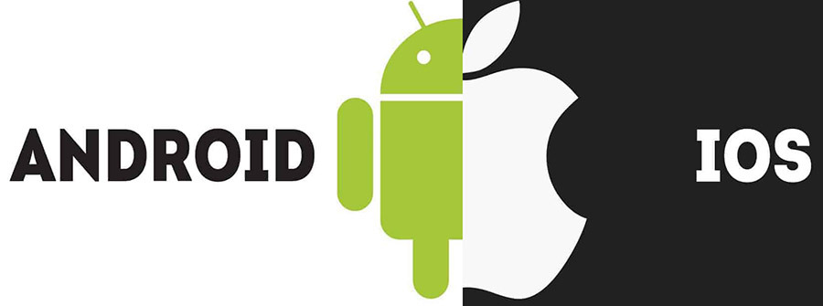
BY:-K.LAHARI GROUP:=MSC’s roll no:-18AF706

Slide 2
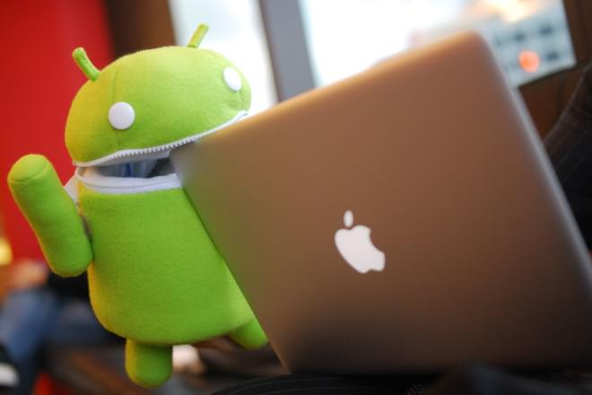
THINGS WE ARE GOING TO SEE
INTRODUCTION
DEVICES
FEATURES
COMPARISON
CONCLUSION

Slide 3
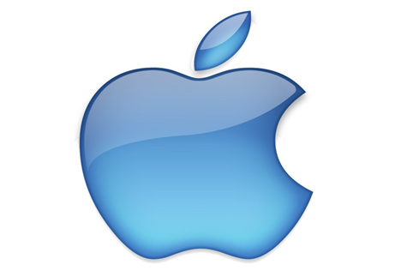
LET’s TALK ON IOS IOS is a mobile operating system which is provided by apple inc. It is mainly designed for apple devices such as iPhone , ipod touch. It is mainly written in C,C++,Objective-c Assembly language and Swift. It was launched in July 29,2007 Its kernel type is hybrid IOS devices are present with 34 languages Closed source

Slide 4
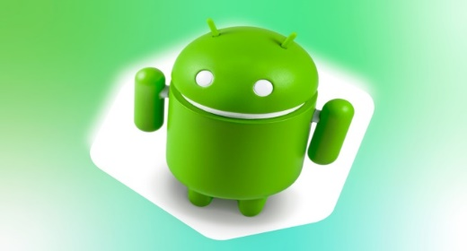
LET’S TALK ON ANDROID
Android is a moblie operating system which is provided by google llc.
ANDROID IS AN OPEN SOURCE
OPEN FOR INNOVATION
it is specially designed for touchscreen mobile devices like smartphones and tablets.
it was developed using java,c++ and other languages.
its kernel type is linux-based.
it was launched in september 23,2008.
android devices are present in 100+ languagues

Slide 5
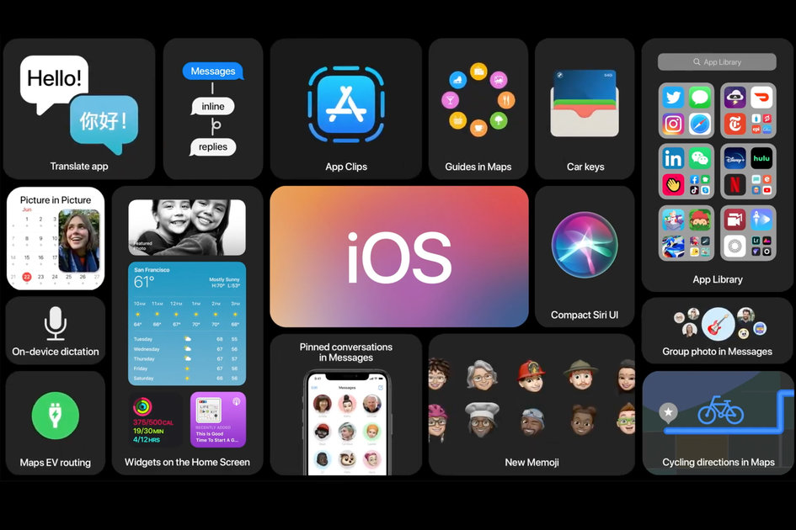
Features of iOS
Multitasking
Siri voice assistant
Gaming
Interface
Applications
Apple store
Safari
High level security (data encryption)
Software Updates
facetime
Hardware (including a7 bionic chipset and latest sensors)

Slide 6
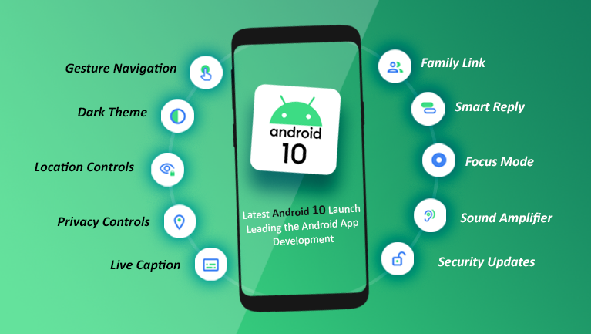
Features of Android
Play store
Google assistant
Web browser
Messaging
Applications
Google maps
Video calling
External storage
SNAPDRAGON, EXYNOS AND OTHER 3RD PARTY CHIPSETS

Slide 7
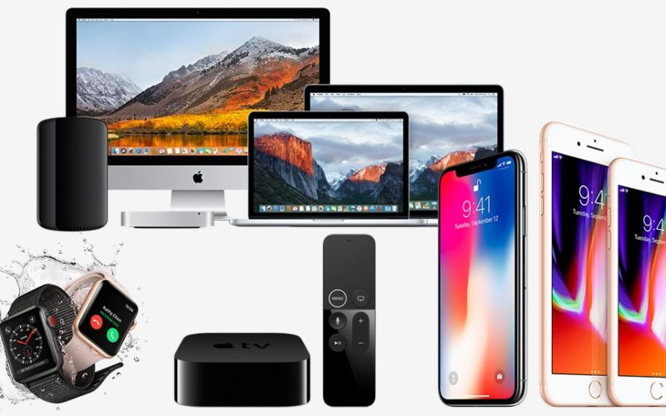
IOS FORM FACTORS

Slide 8
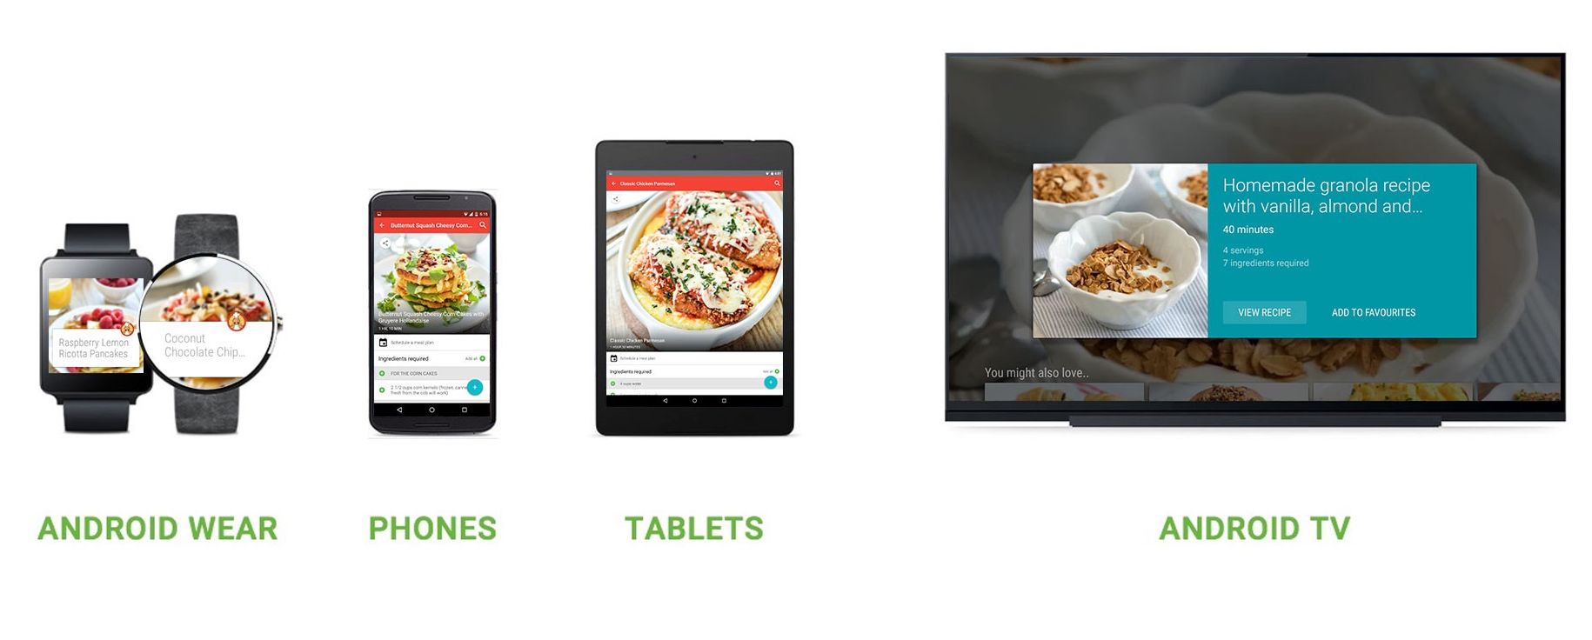
ANDROID FORM FACTORS

Slide 9
ANDROID VS IOS
Parameters | Android | IOS
Customizability | A lot. Can change almost anything. | Limited unless jailbroken
Alternative app stores | Several alternative app stores other than the official Google Play Store | Apple blocks 3rd party app stores
Photos & Videos backup | Google Photos, OneDrive, Amazon Photos and Dropbox | iCloud, Amazon, Dropbox, Flickr and Microsoft
Biometric Authentication | Fingerprint and/or Face Authentication | Fingerprint or Face Authentication, Face ID available on iPhone X

Slide 10
Conclusion
In conclusion both the Android OS and the apple IOS have their own pluses and minuses. Both are equally strong contenders and are bound to rule the app marketplace with their own strength and positives.
There is very little between the two, although the open source nature of Android offers the opportunity for a more diverse range of apps, if not more in actual number. With the iPhone OS you are restricted to apps and other software that Apple approves, while Android is open to anyone that wants to use the operating system to design an application.

